Slide 1

Understanding bank customer behavior : a Data-driven Analysis
Presented by:
Pd18_067 Harshal Chopade

Slide 2
Primary goals
Identifying opportunities to increase revenue and profitability through targeted marketing and sales efforts.
Improving operational efficiency by identifying and addressing customer behavior.

Slide 3
Key Findings & Observations
Maximum no. of customer joined by month: 324 (​October)
Most customer joined by Age-group : 31-40 (1567)
Maxi​mum deposit received by Age & Gender in year: 4.3 M (30-40 Age) (Female)
Maximum customer joined by Region: 2159 (England)
Minimum customer joined by Region: 211 (Wales)
Customer by Job Type: White Collar
Maximum deposit received by Region: 84.83M (England)
Minimum deposit received by Region: 8.3 M (Wales)

Slide 4
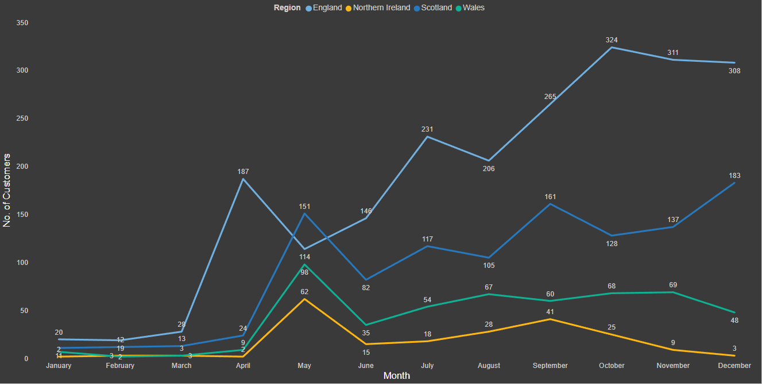
Customer Joined by Month in Regions

Slide 5
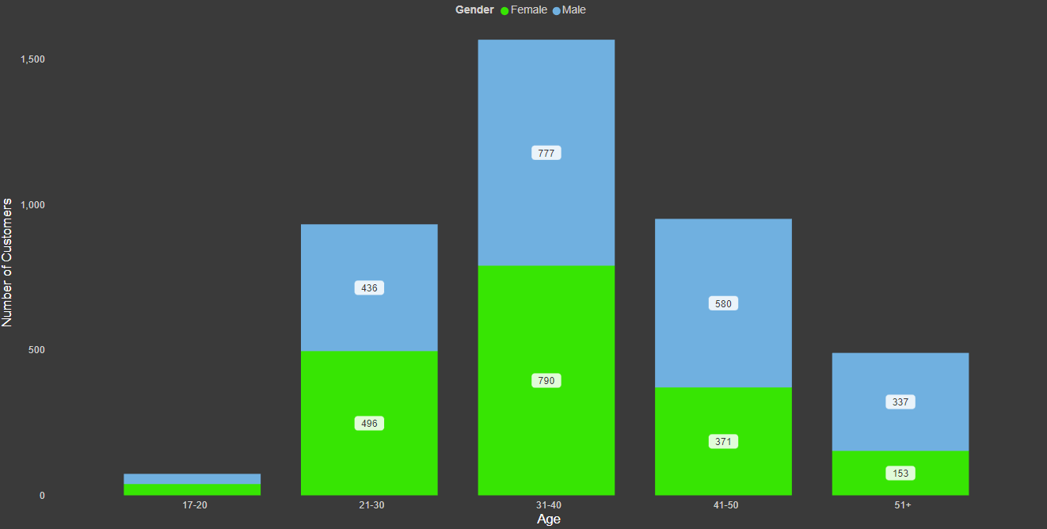
Customers by Age & Gender

Slide 6
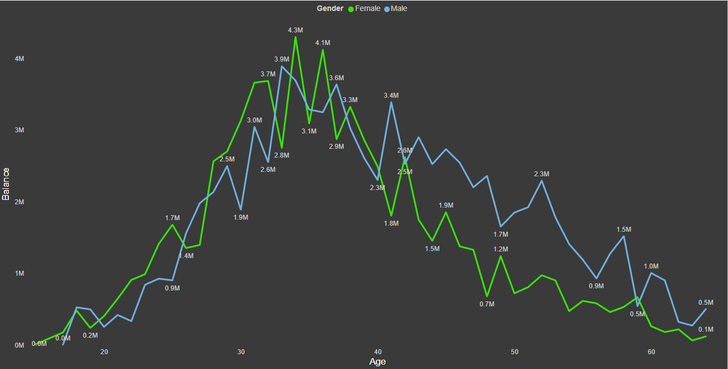
Total Deposit by Age & Gender

Slide 7
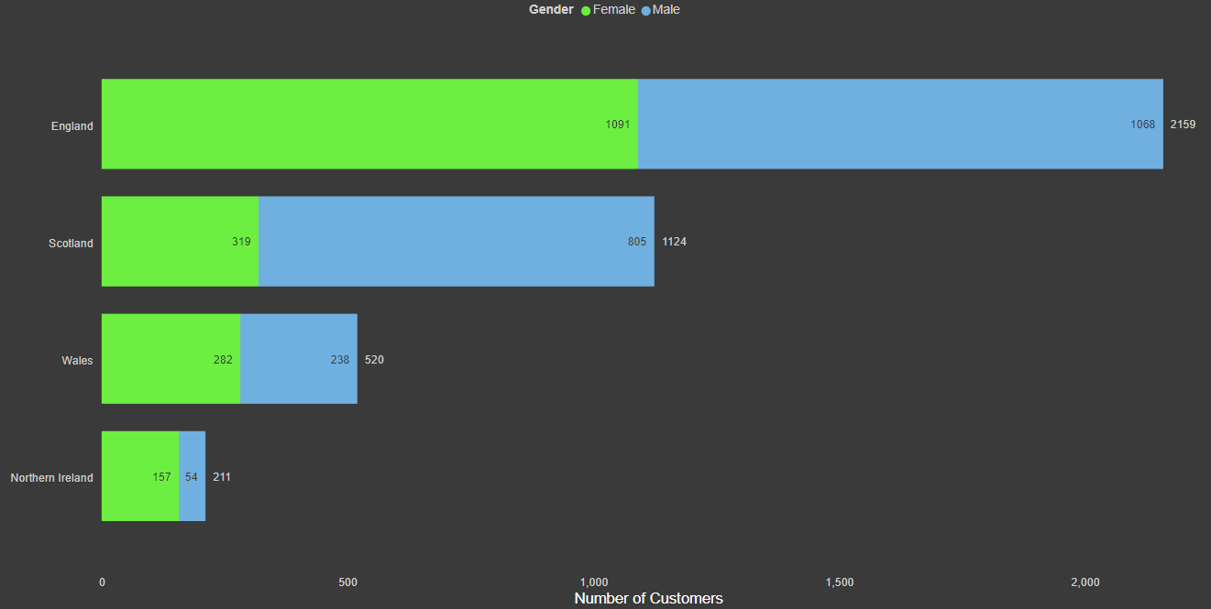
Total Customers by Region

Slide 8
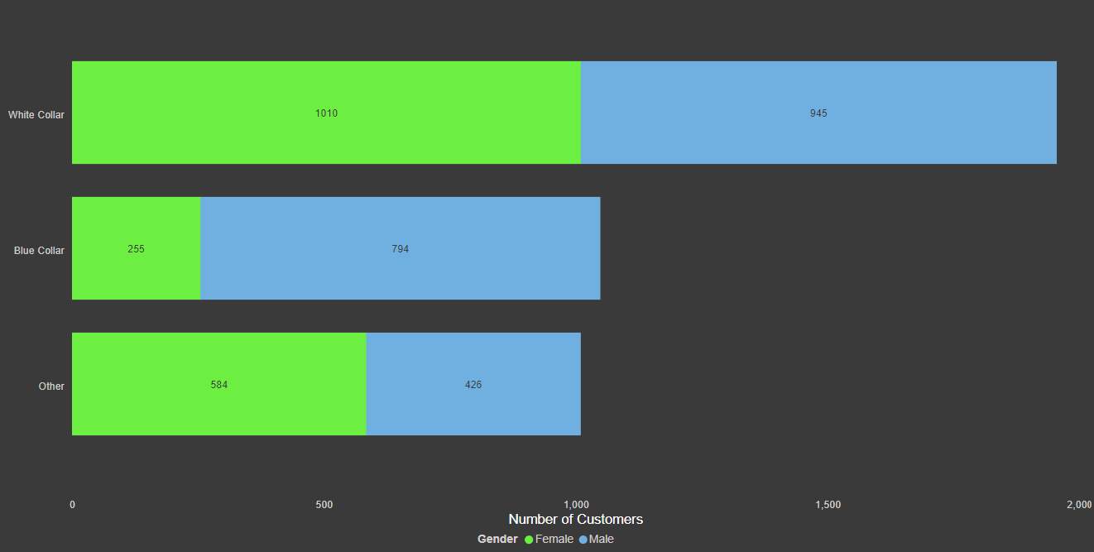
Total Customers by Job Type

Slide 9
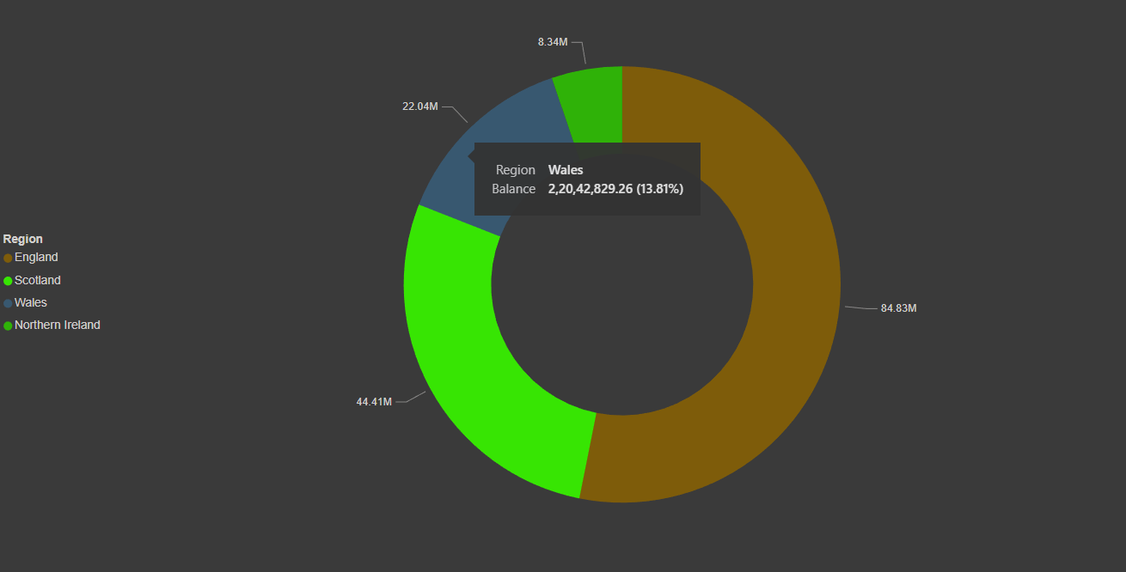
Total Deposit by Region

Slide 10
Conclusion
1. Number of customer joining improved from April in England & Scotland but decreased in Northern Ireland & Wales. Bank should find the factor behind the decrease in number of customer.
2. Most of the customer belongs to 31-40 Age group, Bank should focus on attracting customers from other age group.
3. Till age of 35, Females were keeping most balance but after 35 the balance is decreasing. Bank should come with offers or rewards on deposits done by females so that the deposit will increase.
4. Bank has less number of customers from Wales & Northern Ireland. Bank should develop strategies to improve their business in these regions.
5. Compared to the number of customers by job type, Female from Blue collar job type are in less ratio compared to others. Bank should bring some offer for females so that number of females will increase.

Slide 11

Thank you
Harshal Chopade.
Pd18_067

